Slide 1
RA Assignment 1 - Group 3
Chandra Sekhar Rachannagari
Maha Vajeeshwaran Navaneethan
Stefanos Sakellariou
Youheng Lü

Slide 2
Structure
Critical review of the work of Group 4
Haimes 2009
Cox 2011
Cox 2009
Summary

Slide 3
Haimes 2009

Slide 4
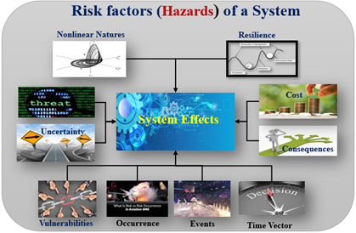
Haimes 2009 - Risk & Nature of Risk
Risk - Yacov Y. Haimes
Risk is a systems-based philosophical and methodological approach
Risk is a measure of system adverse effects.
Describing System Risk Factors
Theory of Scenario Structuring (TSS)
What can go wrong? Kaplan and Garrick
What is the likelihood?
What are the consequences?
Risk Analysis
• Study of the system states
• Performance of a system
• Vulnerability
• Consequences of event
• Resilience vectors

Slide 5
Haimes 2009 - Risk & Risk Modeling
Risk Modeling - Benefits of Risk Management
• Mitigations, Multiple-Criteria Decision Making (MCDM), actionable measures, cost reduction,
low vulnerabilities and increase in system resilience.
Risk Modeling - Misuse
• Misclassification of consequences Low & Outlier - not regular occurrence and human nature
Critical Reflection
“.. the time to recover from a yet unknown and maybe unpredictable hazard should always be assessed by implementing a security buffer and this is missing in Haimes’ paper.”
Misuse of extreme events has not addressed
Security buffer not always necessary

Slide 6
Cox 2011

Slide 7
Cox 2011 Example 1
“This is paradoxical as one would expect that the greater the input uncertainty, we should expect a greater output uncertainty, which Cox himself highlights”.
Critical reflection:
While we understand the group’s point, that isn’t quite what Cox 2011 said.
If the threshold value is increased, it will lead to a different example.
We agree with Cox’s statement.

Slide 8
Cox 2011 Example 2
Critical reflection:
Even though Cox 2011 provided some wrong SIS model for the epidemic, we agree with the statement.
That is one of the most important takeaways from this study, that the utility of a model is heavily dependent on context.
A model with high accuracy may be used for the short duration, but it cannot be used for the long duration.

Slide 9
Cox 2011 Example 3
Critical reflection:
We disagree with the article and Cox’s third example.
It is not true and applicable that statistical models will always predict correct outcomes.
For assessing the risk, causality should also be considered.

Slide 10
Cox 2009

Slide 11
Cox 2009
Common ground
Identifying all the correlations might be too complex.
Priority scoring systems can be useful.
Why these optimization methods have not been widely used?

Slide 12
Cox 2009
Room for improvement
Critical reflection overlaps with summary.
Opinions supported by weak arguments.
Examples poorly presented, insufficient explanation.

Slide 13
Summary

Slide 14
Summary
Group 4 focused on summarizing, few own opinions
Haimes 2011: Misuse of extreme events not covered
Cox 2011: Misinterpretation of Example 1
Cox 2009: Points supported by weak example

Slide 15
Any questions?

